Slide 1



Improving Customer Experience in Telecomunication:
Customer Churn Prediction and Market Segmentation
Let’s Get Started!

Slide 2



Team Profile – Trifect Adventurer
Dimas Surya Prasetyo
Bagaskara Adhi Pradana
Abigeil Febiola Sabatini
Bachelor of Informatics Engineering
Bachelor of Informatics Engineering
Bachelor of Informatics Engineering

Slide 3
Introduction
Background of the topics and issues raised
Understanding customer behavior is a key challenge for the telecommunications industry, which is characterized by ever-increasing customer needs and innovation. In this case, the main topic discussed is customer behavior analysis. These topics include understanding service usage patterns, components that influence customer satisfaction, and the formation of useful knowledge. To maintain competition and understand customer preferences, rapid changes are needed in the industry. On the other hand, there is a direct link between understanding customer preferences and the ability to provide an exceptional experience. Understanding customer behavior has become critical to maintaining enterprise success and ensuring telecommunications companies remain at the forefront in a dynamic and competitive landscape as the industry becomes increasingly connected.

Slide 4
Data & Tools
Dataset & Tools Used in Research
Data Source :
Tools :
Data Challenge DSW 2023 - Student & Junior Pro
Google Colaboratory
The dataset shows the usage of telecommunication services in Q3 of a particular year adapted from a Kaggle public dataset with several modifications.
For data processing, analysis, modeling, and visualization.
Excel / Spreadsheet
To see an overview of the data and prepare the data for further analysis.

Slide 5





Methodology
Method used in Research
Data Cleaning & Pre - processing
Modelling
This phase involves cleaning, transforming, and organizing data to ensure it is suitable for analysis.
In this step, statistical or machine learning models are applied to the prepared data to make predictions or draw conclusions.
Exploratory Data Analysis
Evaluating
EDA focuses on understanding the dataset through visualization and statistical tools to uncover insights and patterns.
The final step assesses the model's performance by using various metrics to determine its accuracy and effectiveness.

Slide 6

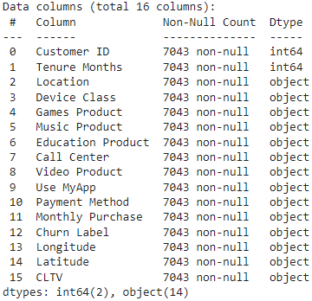
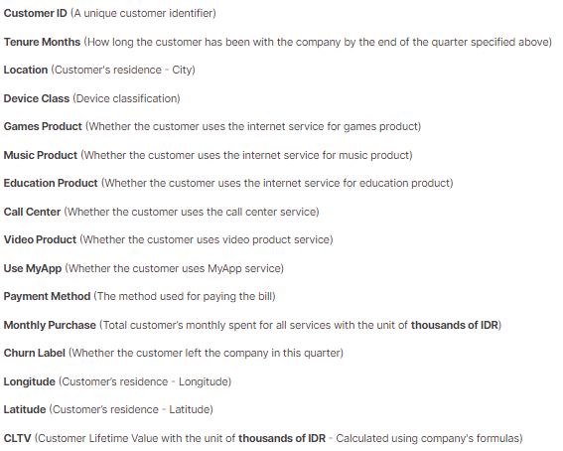
About Data
Understanding Data
Kaggle
Data Challenge DSW 2023
- Student & Junior Pro Dataset
7.403
Rows
16
Columns

Slide 7





Data Pre - processing
Cleaning and Transforming Data
Missing Value
Statistical Summary
Handling Outlier

Slide 8
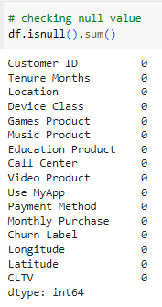
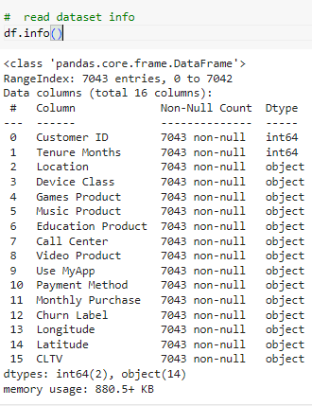
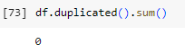
Missing Value
Handling the missing value
There’s no duplicated data
There’s no missing value

Slide 9
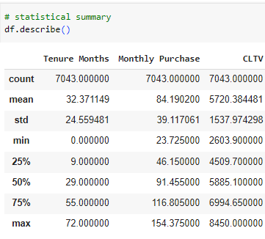
Statistical Summary
Statistical Summary of Numeric Data
Conclusion :
Tenure Months data shows a wide variation in customer loyalty or subscription duration, suggesting the need for strategies to retain customers over time.
Monthly Purchase information highlights varying spending patterns among customers, with a moderate level of spending diversity.
CLTV data indicates differences in customer lifetime value, highlighting the need of focusing marketing efforts on client segments.

Slide 10
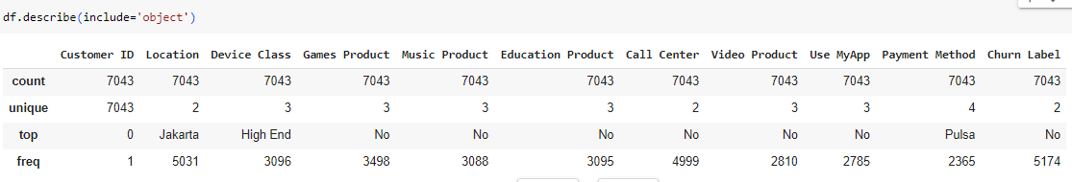
Statistical Summary
Statistical Summary of Categorical Data
Conclusion :
From the top value and their frequency, we gain insight into the most common data points.

Slide 11
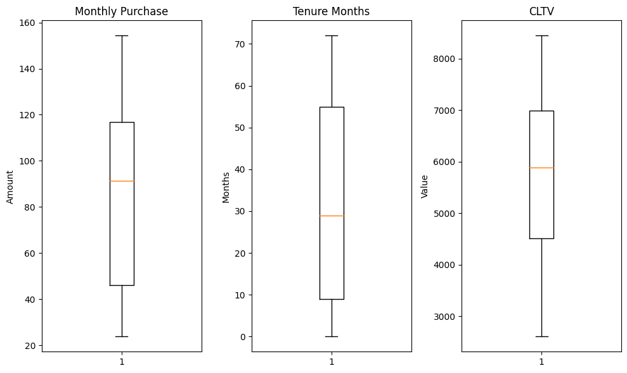
Outliers
Handling Outlier
Other outliers indicate data diversity. In the numeric data, there are no outliers, so further analysis can be carried out.

Slide 12




Exploratory Data
Analysis
Data Distribution
Data Visualization
Deep-dive Exploration
Conclusion

Slide 13
Data Distribution

Slide 14
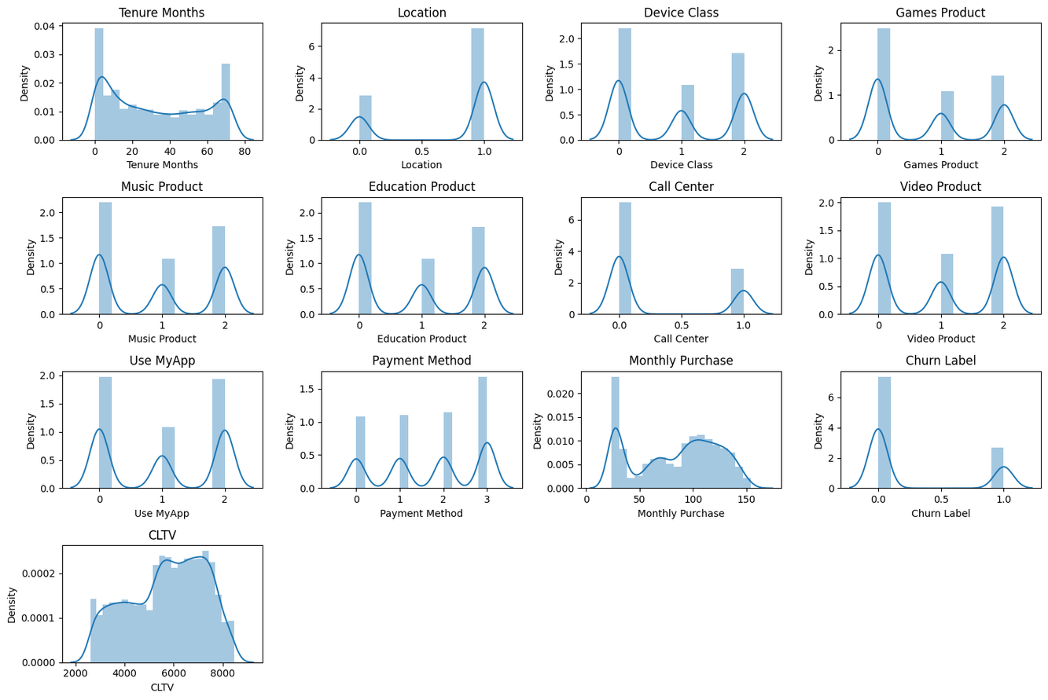
Data Distribution
Conclusion :
The spread is quite diverse

Slide 15
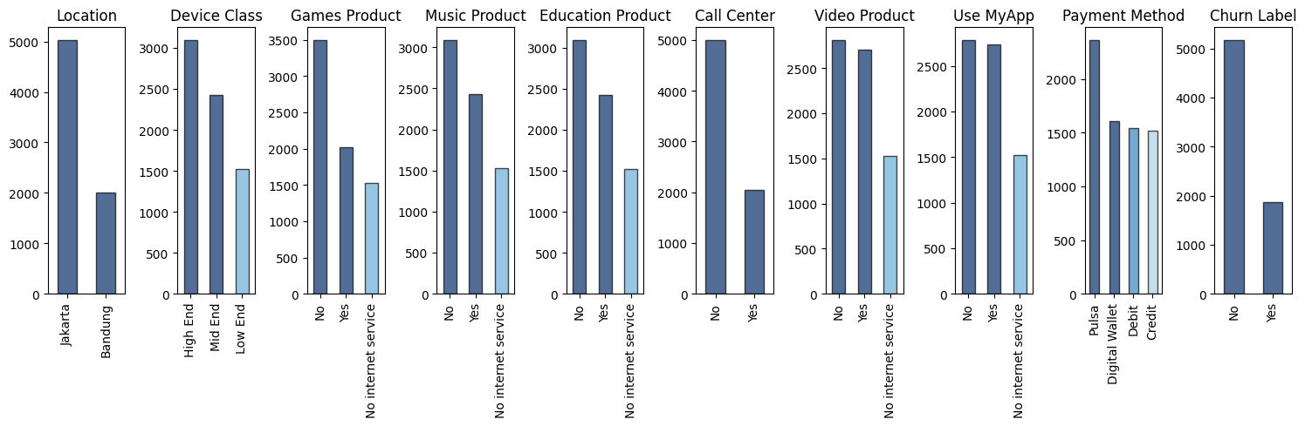
Univariate Analysis
Conclusion :
the categorical columns tend to be imbalance. this will have an impact when
segmentation is performed later.

Slide 16
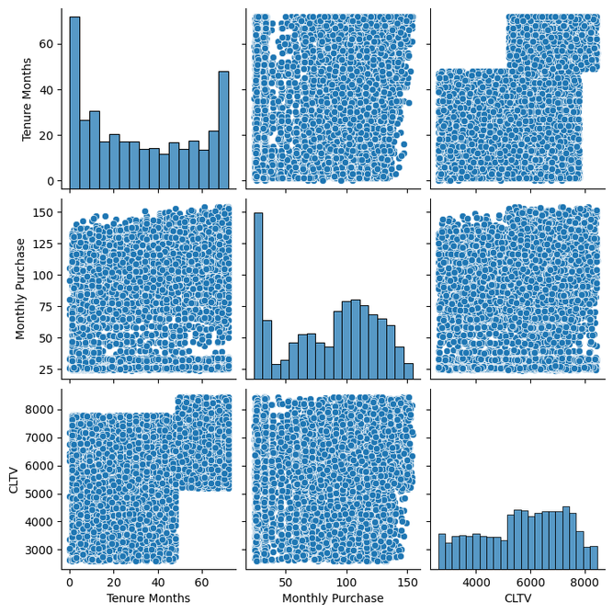
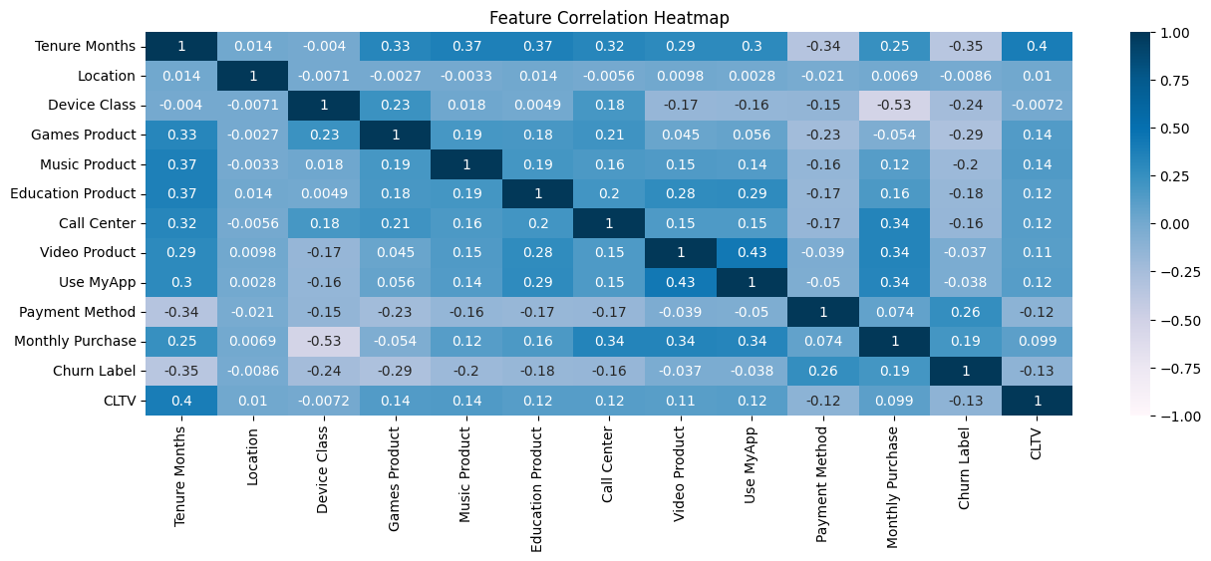
Multivariate Analysis
low correlation will have impact on segmentation later

Slide 17
Data Visualization

Slide 18
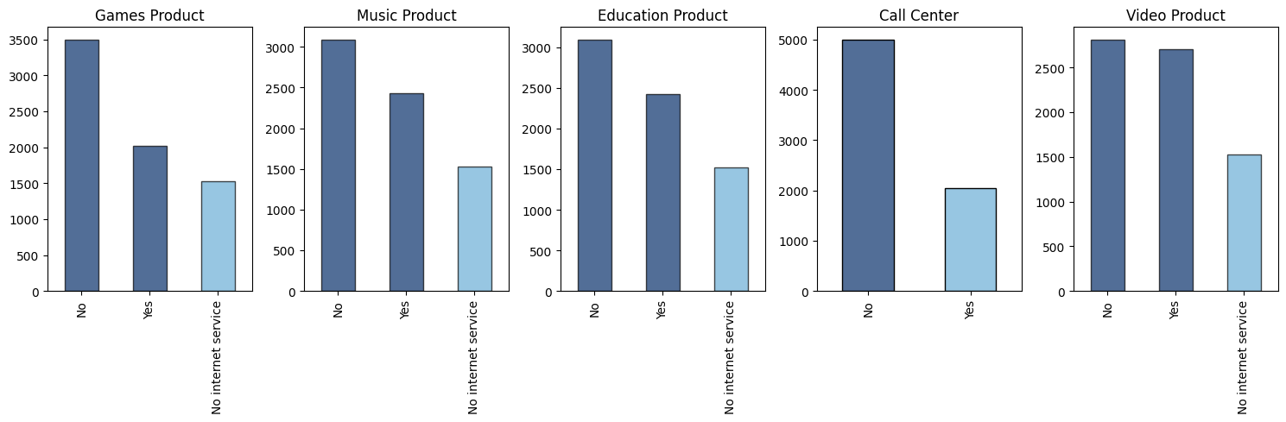
Number of Products Type Uses
Conclusion :
Video services are the most popular among customers, with usage almost even between "Yes" and "No".
Games, Music and Education services were less popular.
1526 customers do not have internet service in their packages.

Slide 19
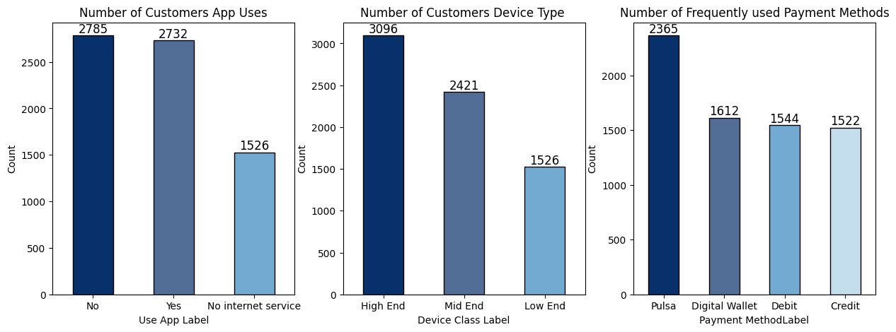
Number of Payment Method Uses
Conclusion :
Pulsa has the highest share in the number of transactions and is also the most dominant payment method with 33.6% of total transactions. This shows that more customers choose to use Pulsa as a payment method.
Digital Wallet, despite having a significant number of transactions, is still below Pulsa. This shows that although quite popular, the use of digital wallets has not yet reached the level of credit adoption.
Debit and Credit are in almost equal proportions, with Debit being slightly higher. This indicates that most customers prefer to use their debit or credit card as a payment method.

Slide 20
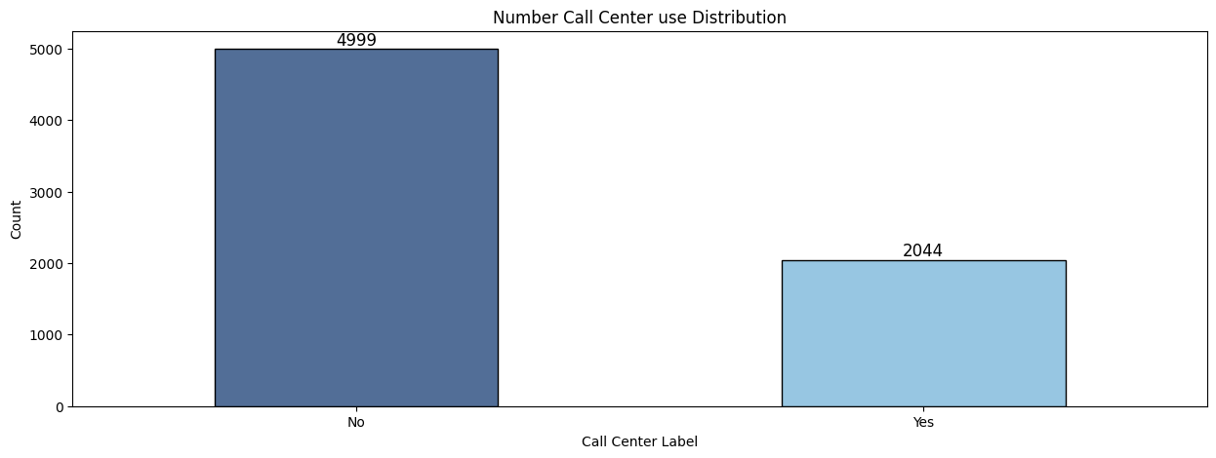
Number of Call Center Uses
Conclusion :
The total number of customers who use call center service is 2044, while those who do not use are 4999.

Slide 21
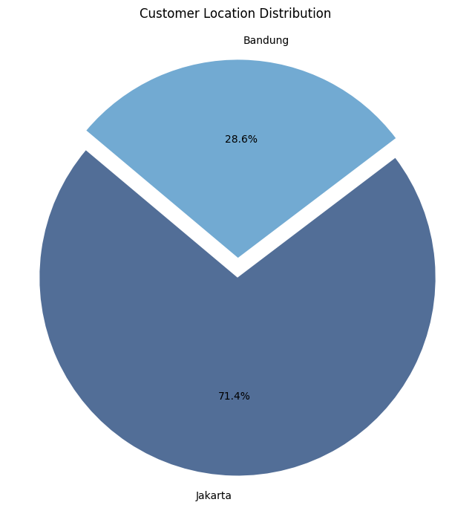
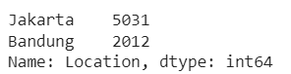
Customer Location Distribution
Conclusion :
Jakarta has more customers than Bandung, with 5031 customers (around 71.4%) located in Jakarta and 2012 customers (around 28.6%) located in Bandung.
This depicts the distribution of customers per location clearly, with the majority of customers being in Jakarta.

Slide 22
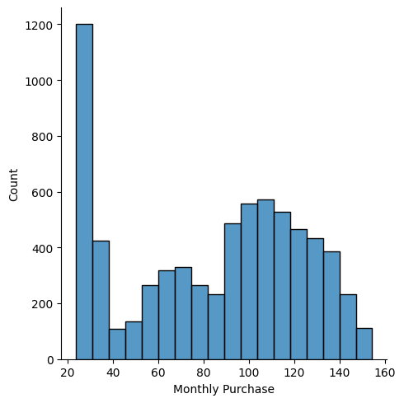
Monthly Purchase Distribution
Conclusion :
The highest purchase frequency is in the range of 20-40 thousand rupiah, with a total of 1600. This shows that most customers make purchases of relatively small value.
Only a small percentage of customers make purchases of relatively large value.
Purchase frequency patterns tend to decrease from the lower value range to the higher value range.

Slide 23
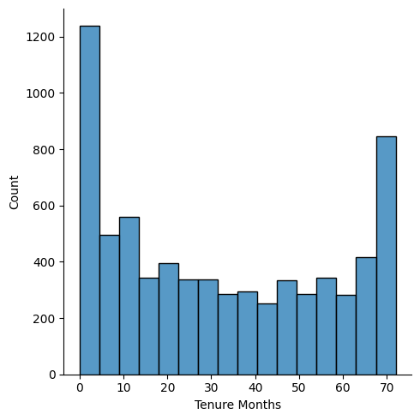
Tenure Months Distribution
Conclusion :
The distribution of length of service usage is quite even, with the majority of customers (50%) having a usage period of less than 29 months.
There was significant variation in length of use of the service, with some customers being new and some customers having been using the service for a long time.
The existence of customers who have used the service for 6 years (72 months) shows that there is a very loyal group of customers.

Slide 24
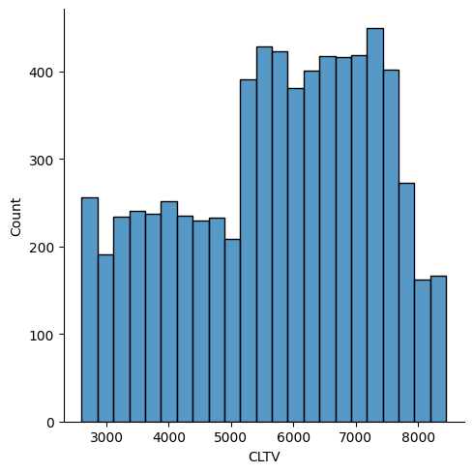
Customer Lifetime Value Distribution
Conclusion :
The distribution of CLTV values ​​is quite varied, with the majority of customers (50%) having CLTV values ​​below 5885.10.
There is significant variation in CLTV values, with some customers having low CLTV values ​​and some customers having high CLTV values.

Slide 25
Deep-dive Exploration

Slide 26
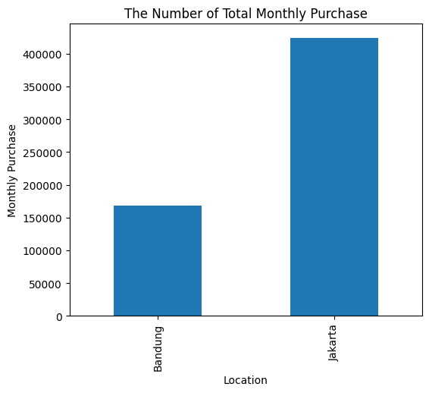
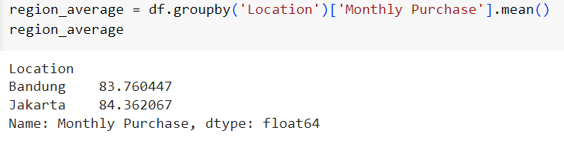
Monthly Purchase by Location
Recommendatiion :
Segment the customers based on their purchasing behavior and demographics.
Explore the monthly purchase trends over time for both locations. Look for any seasonal patterns, trends, or anomalies that could provide insights into the purchasing behavior of customers.
Evaluate the impact of marketing campaigns on customer engagement and purchasing behavior.

Slide 27
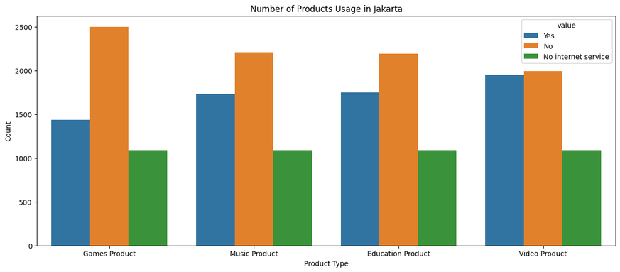
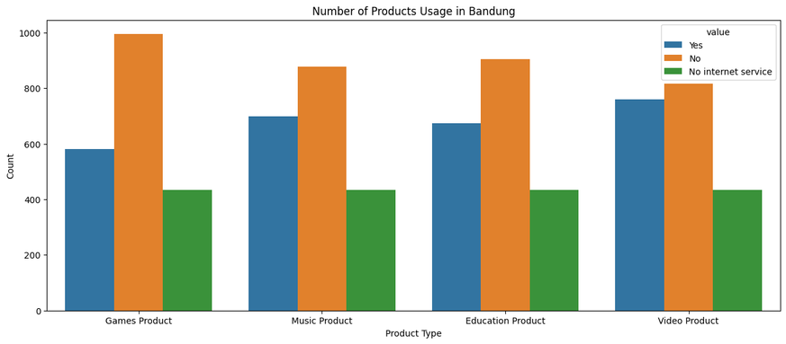
Products Usage by Location
Recommendation:
Product Optimization in Each Location:
Identify products that have a low frequency of use in each location.
Check whether the product is not in demand or whether additional marketing strategies are needed.
Marketing Strategy Adjustments:
Customize marketing strategies for each product based on customer preferences in each location.
There may need to be promotions or special offers tailored to the needs and preferences of customers in Bandung and Jakarta.
Joint Product Analysis:
Conduct further analysis to see if there are patterns or trends in the use of product combinations at each location.
Consider putting together product packages or offering combination promotions based on customer preferences in each location.
Internet Service Evaluation:
Check customers who have the label "No internet service" to see if they really don't use internet service.
Consider offering appropriate internet packages or marketing strategies, especially if there are customers in both locations who do not use internet service.

Slide 28
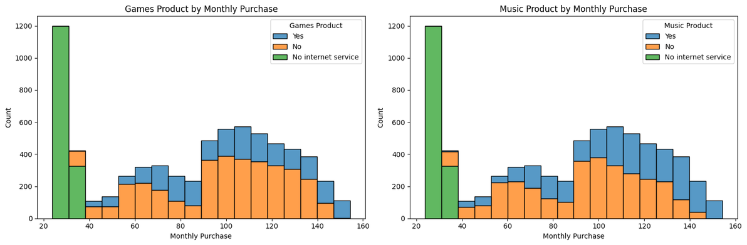
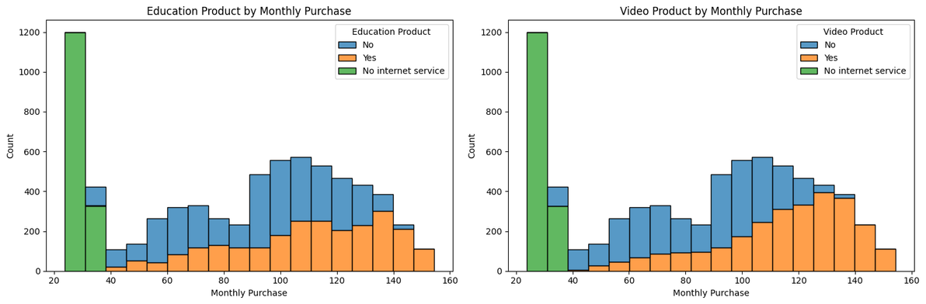
Products Usage by Monthly Purchase
Recommendation :
It is necessary to identify the cause of "No internet service" and ensure that customers in all locations have adequate access to the internet.
Consider creating product bundle offers or subscription packages that can increase customer interest and motivate the purchase of more products.

Slide 29


Conclusion
In majority, Jakarta has the highest monthly purchase
Recommendation :
It is necessary to evaluate product marketing in Bandung, and adjust customer preferences and improve service in each location.
No internet service is Quiete High in Each Products
Recommendation :
because the number of customers who experience no internet service greatly influences customer churn. It is best to immediately identify the cause of no internet service in customers in each area to improve service performance.

Slide 30


Machine Learning
Churn Prediction
Customer Segmentation

Slide 31






Step
Data Cleaning
Feature Engineering
Modeling
Evaluating

Slide 32


Data Cleaning
Missing Value
Duplicated Value
Outliers
There’s no missing value in the dataset
There’s no duplicate value
No Outliers in dataset

Slide 33
Feature Engineering
Encoding
Scaling
Imbalance
10 Variable
Standard Scaler
Imbalance will be left to avoid overfitting
Device Class
Location
Games Product
Music Product
Education Product
Call Center
Video Product
Use MyApp
Payment Method
Churn Label

Slide 34


Modeling
Logistic Regression Model
Random Forest Model

Slide 35
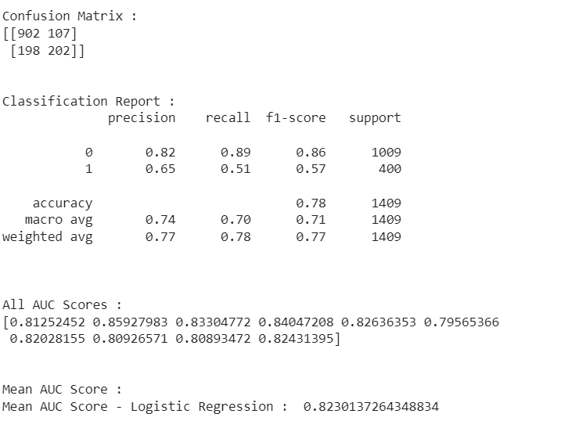
Logistic Regression Model Evaluation
The model successfully identified 902 negative cases and 202 positive cases correctly.
There were 107 cases that should have been negative but were incorrectly identified as positive.
A total of 198 positive cases were not detected by the model.
The overall accuracy of the model was 0.78, which reflects the extent to which the model actually classified instances correctly
The model tends to be better at classifying the negative class (0) than the positive class (1).
This Logistic Regression model has good performance with an AUC of around 0.82, however, it is still possible to carry out further exploration to improve performance, especially for positive class recall.

Slide 36
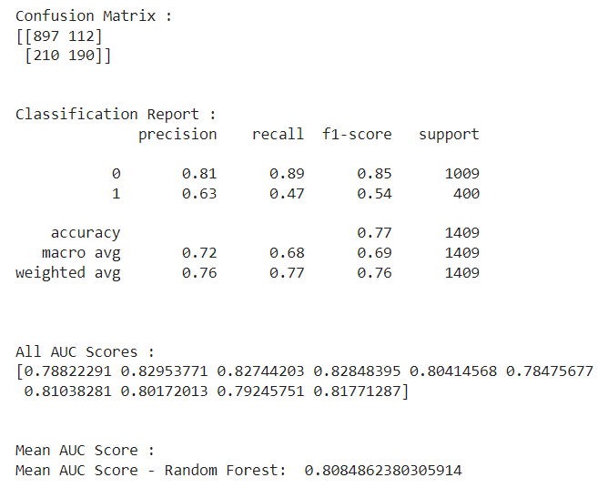
Random Forest Model Evaluation
The model successfully identified 895 negative cases and 184 positive cases correctly.
There were 114 cases that should have been negative but were incorrectly identified as positive.
A total of 216 positive cases were not detected by the model.
The overall accuracy of the model was 0.77, reflecting the extent to which the model actually classified instances correctly.
The mean AUC score of 0.81 indicates that the model has good performance in distinguishing between positive and negative classes. AUC above 0.8 is considered good.
The model tends to be better at classifying the negative class (0) than the positive class (1).

Slide 37
Conclusion
VS
Logistic Regression Model
Random Forest Model
Accuracy:
Logistic Regression had slightly higher accuracy (78% vs. 77%).
Precision:
Both Logistic Regression and Random Forest have higher precision for class 0
(negative) than for class 1 (positive).
Recall:
Both Logistic Regression and Random Forest have higher recall for class 0
(negative) than for class 1 (positive).
F1-Score:
Both Logistic Regression and Random Forest have a higher F1-score for class 0
(negative) than for class 1 (positive).
AUC-ROC:
Logistic Regression has a slightly higher Mean AUC Score (0.82 vs. 0.81).
Conlcusion :
In general, both models show similar performance, with Logistic Regression tending to provide a slight edge in some evaluation metrics.
The choice between Logistic Regression and Random Forest can depend on data characteristics, model interpretation, and specific project needs.
If model interpretability and ease of configuring the model are important, Logistic Regression may be preferred.
If model complexity and the ability to handle non-linear features are priorities, Random Forest can be a good choice.

Slide 38
Customer Segmentation

Slide 39
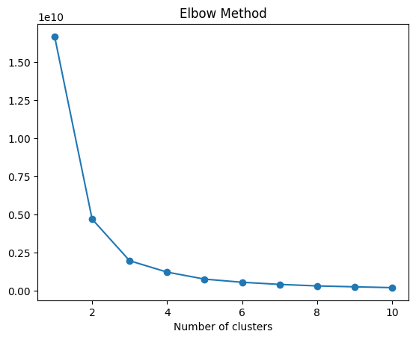
Modeling: Elbow Method

Slide 40
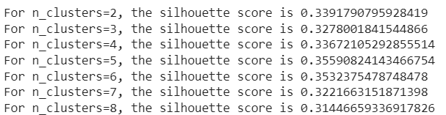
Modeling: Shillouette Score
Conclusion :
The best number of clusters (n_clusters) may be the value that gives the highest Silhouette score. In this case, n_clusters=5 has the highest Silhouette score.
It is important to remember that Silhouette Score evaluation should be used in conjunction with an understanding of the data domain and external evaluation to ensure selection of the optimal number of clusters.
The higher the Silhouette score, the better the cluster is considered to be within clearer boundaries.

Slide 41
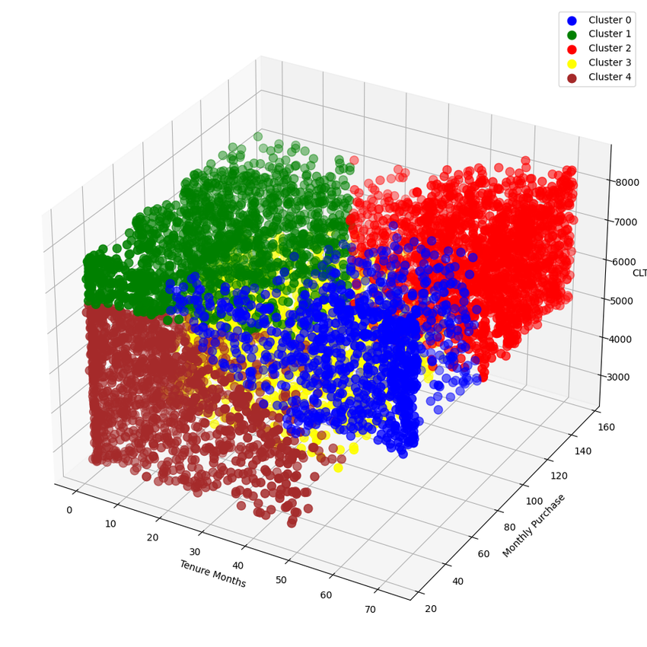
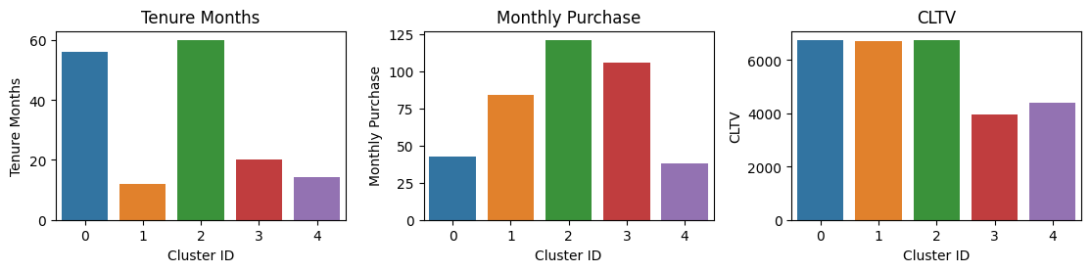
Modeling: K-means Clustering
Cluster 0 and Cluster 2 have high CLTV values, indicating good customer value, while Cluster 3 and Cluster 4 have lower CLTV values.
Cluster 0 and Cluster 2 also have longer tenure and high monthly purchase rates, indicating loyal customers with good financial contributions.
Cluster 1 has a high CLTV value despite a low monthly purchase rate, indicating the growth potential of these customers with the right marketing strategy.
Cluster 3 and Cluster 4, although having moderate to long tenure, have lower CLTV values, and may need special attention to increase their financial contribution.

Slide 42
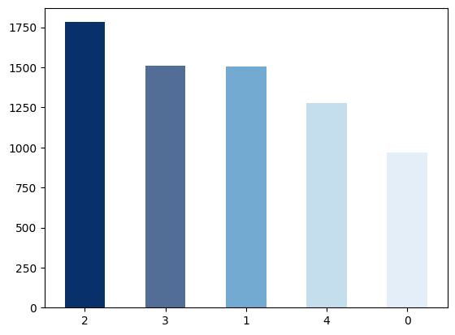
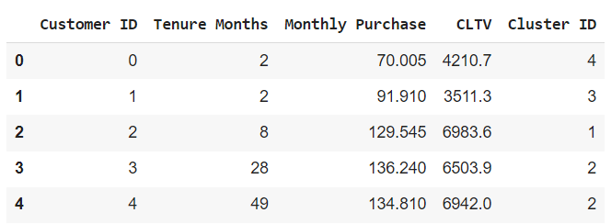
Evaluating: Cluster
Conclusion :
Cluster 2 and Cluster 3 are the largest clusters with a significant number of customers.
Cluster 0 has the smallest number of customers.

Slide 43




Analysis: Market Segmentation
High - Value Loyal Customer
Potential Growth Customers
Customers with high monthly purchase rates, high lifetime value (CLTV), and long service life.
Customers with growth potential, good lifetime value (CLTV) despite low monthly purchase rates, and shorter service life.
Moderate-Value Loyal Customers
Low - Value Customer
Customers with medium to low monthly purchase rates and lifetime value (CLTV), but a long service life.
Customers with low monthly purchase rates and lifetime value (CLTV), as well as shorter service life.

Slide 44
Conclusion
Monthly Purchase:
There is significant variation in monthly purchasing levels within each cluster.
Cluster 2 has a high monthly purchase rate, while clusters 0, 1, 3, and 4 tend to have more stable rates.
Customer Lifetime Value (CLTV):
Clusters 0, 2, and 4 have high lifetime values, indicating the potential for significant financial contributions.
Cluster 3 has lower lifetime value, and can be the focus of marketing strategies to increase value.
Tenure Months:
Clusters 0, 2, and 4 have a long period of service use, showing the potential to become loyal customers.
Clusters 1, 3, and 4 have shorter tenures, requiring more intensive retention strategies.

Slide 45
Recommendation
Personalize Customer Experience:
Based on segmentation analysis, personalization of customer experience can be implemented according to the profile and preferences of each cluster.
The Right Retention Strategy:
Clusters with shorter tenures (Clusters 1, 3, and 4) require more intensive retention strategies. Special offers, discounts or loyalty programs can be used to extend their usage period.
Optimize Services for High CLTV Clusters:
Clusters with high lifetime value (Clusters 0, 2, and 4) can be targets for premium services or exclusive offers.
Product Combination Analysis:
Carry out further analysis of the product combinations used by customers in each cluster to optimize package offers or product promotions.
Continuous Monitoring and Evaluation:
Conduct continuous monitoring and evaluation of customer responses to implemented marketing and retention strategies. Adapt strategies according to changing trends and customer preferences.
Improved Communication:
Improve communication with customers through channels that suit the preferences of each cluster.
Use sentiment analysis tools to understand customer feedback and respond quickly.

Slide 46


Thank You!
Any Question? Reach me at:
diimprasetyos@gmail.com
https://www.linkedin.com/in/diimprasetyo/
Google Colaboratory : https://colab.research.google.com/drive/1S4Fym4g-GCBtgHoGxpnqMqF-UIjyr44w?usp=sharing

